Slide 1

HW2: SYNTHETIC CARDS IMAGES GENERATION
Student: Raza Akbar

Slide 2
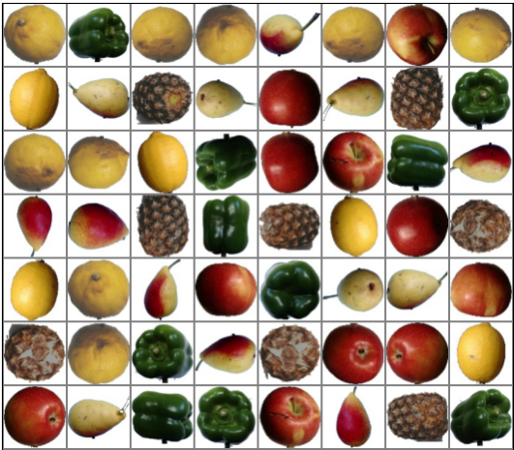
HW2 - Dataset
The dataset used for the homework consists of different types of fruits.
Images Size: 100x100
Training Images: 1829
Validation Images: 392
Test Images: 393
Number of class: 5

Slide 3
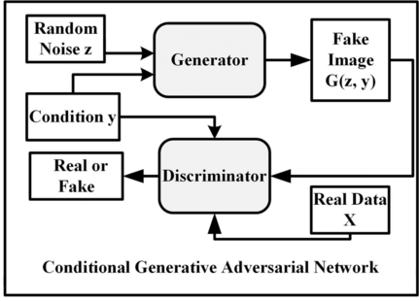
HW2 – GAN Model
The type of the model is Conditional DCGAN
In a Conditional DCGAN, the generator takes additional input to generate more controlled and specific outputs.
The generator to generate samples conditioned on specific classes or attributes, resulting in more targeted and diverse output generation.
The discriminator network is also modified to consider the conditional information when making its discrimination decisions.

Slide 4
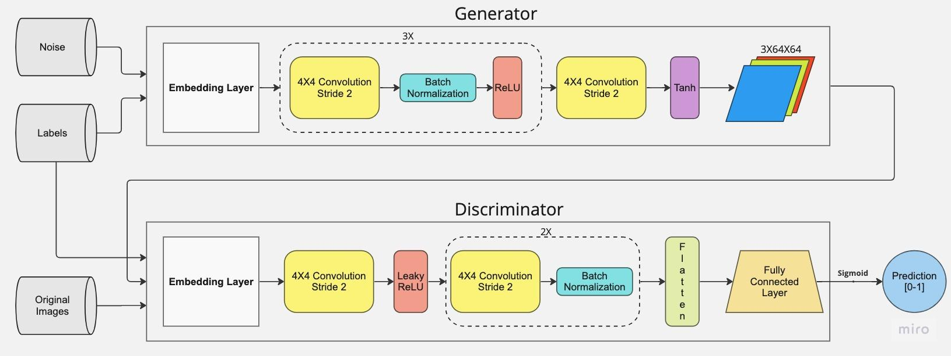
HW2 – GAN Model

Slide 5
HW2 – Training procedure
Hyperparameters
In the training the data have been grouped in batches of 64 elements, shuffled for each of the 1140 epochs that have been performed, while setting 2 as number of workers. All images have been resized to 64X64.
Optimizer
The optimizer used for both generator and discriminator is Adam, with learning
rate=0.0001, beta1=0.5 and beta2=0.999.
The momentum term (beta1) of 0.5 allows a faster convergence during the initial iterations, while the second-order moment term (beta2) of 0.999 helps to stabilize the update steps and to reduce the effect of noisy gradients.
Loss
Both generator and discriminator have as a loss function Binary Cross Entropy (BCE).
FID and Inception score has been calculated every 250 epochs.

Slide 6
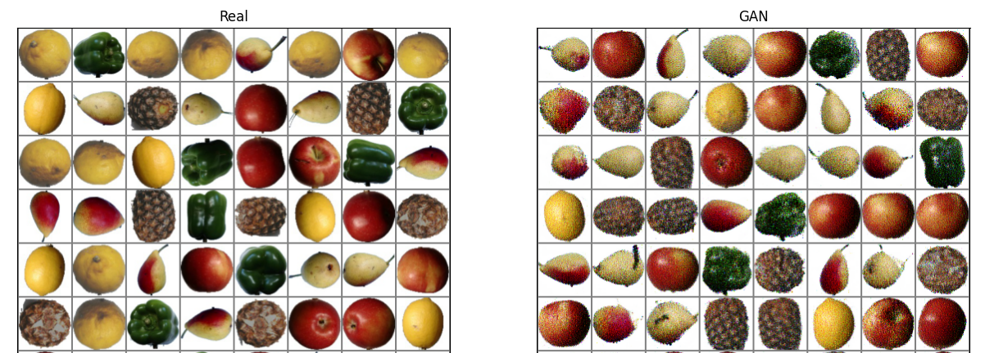
HW2 – Images Generations Results
This is the comparison between a batch of real images and a generated one.
As we can see, the generated images has a big variety between good ones, average, and very noisy.

Slide 7
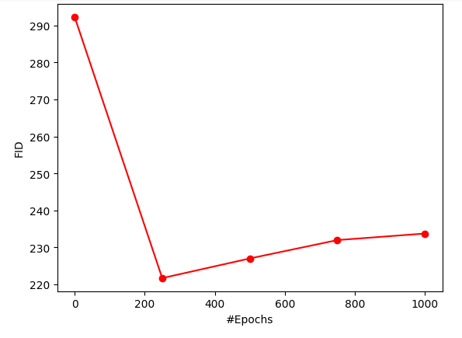
HW2 – Results
The FID is almost stable at around 230 after 750 epochs.

Slide 8
HW2 – GAN-augmented classification results
CLASSIFICATION MODEL:
A classification with a simple CNN has been computed, in order to compare the original dataset with the one with fake images and see a difference in accuracy between the two.
Cross Entropy Loss
Adam Optimizer with learning rate=0.001.

Slide 9
HW2 – Augmented Classifications Results
DATASET: The dataset is the original plus 100 generated images for each class
RESULTS WITH original and GAN Generated Images

Slide 10
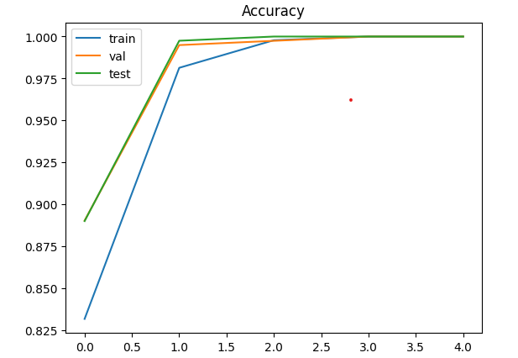
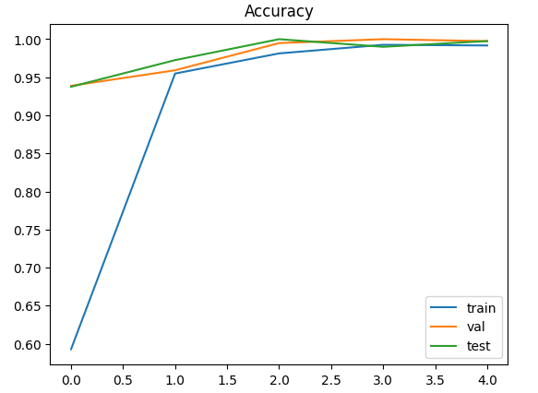
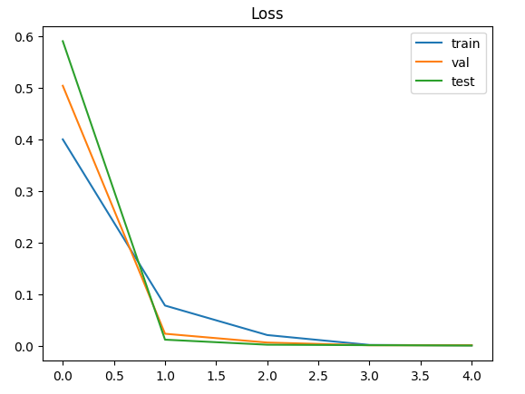
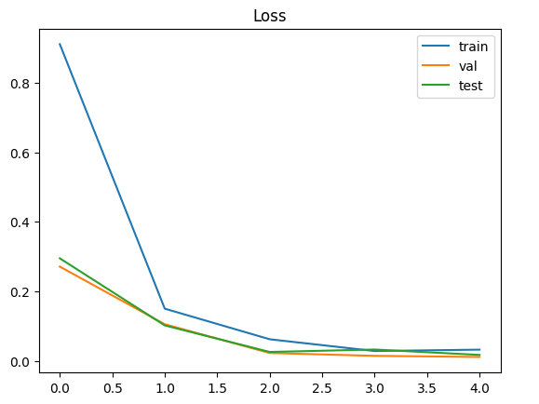
Result with original and GAN Generated Images

Slide 11
Thanks for your attention!

